Slide 3
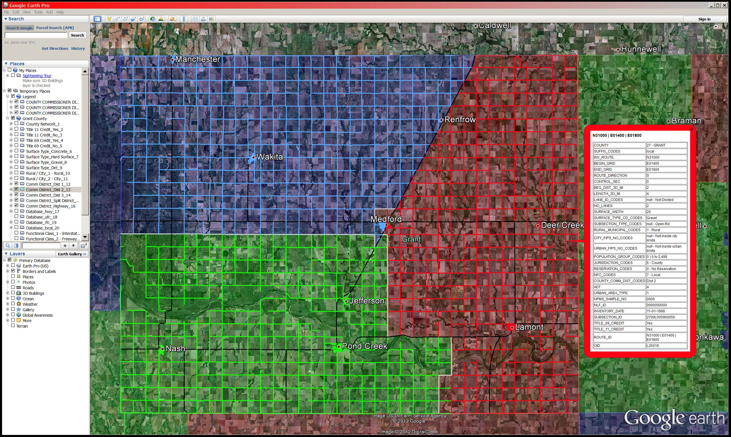
Roadways in County Commissioner Districts Grant County

Slide 4
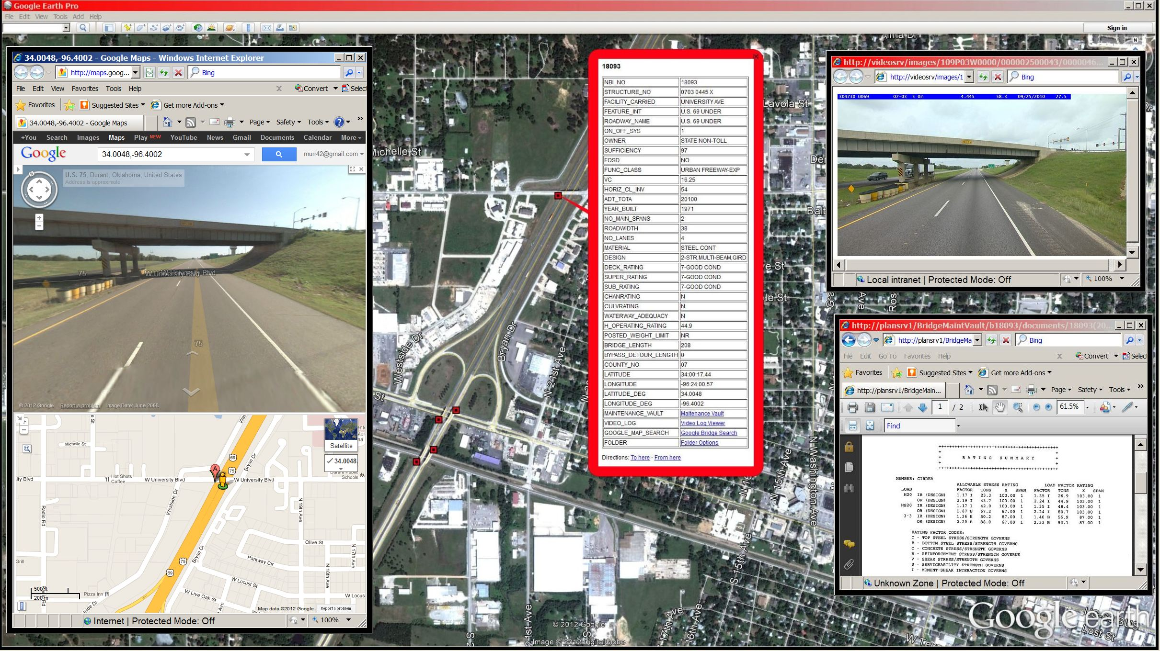
Different options to view when clicking on a Bridge Structure

Slide 5
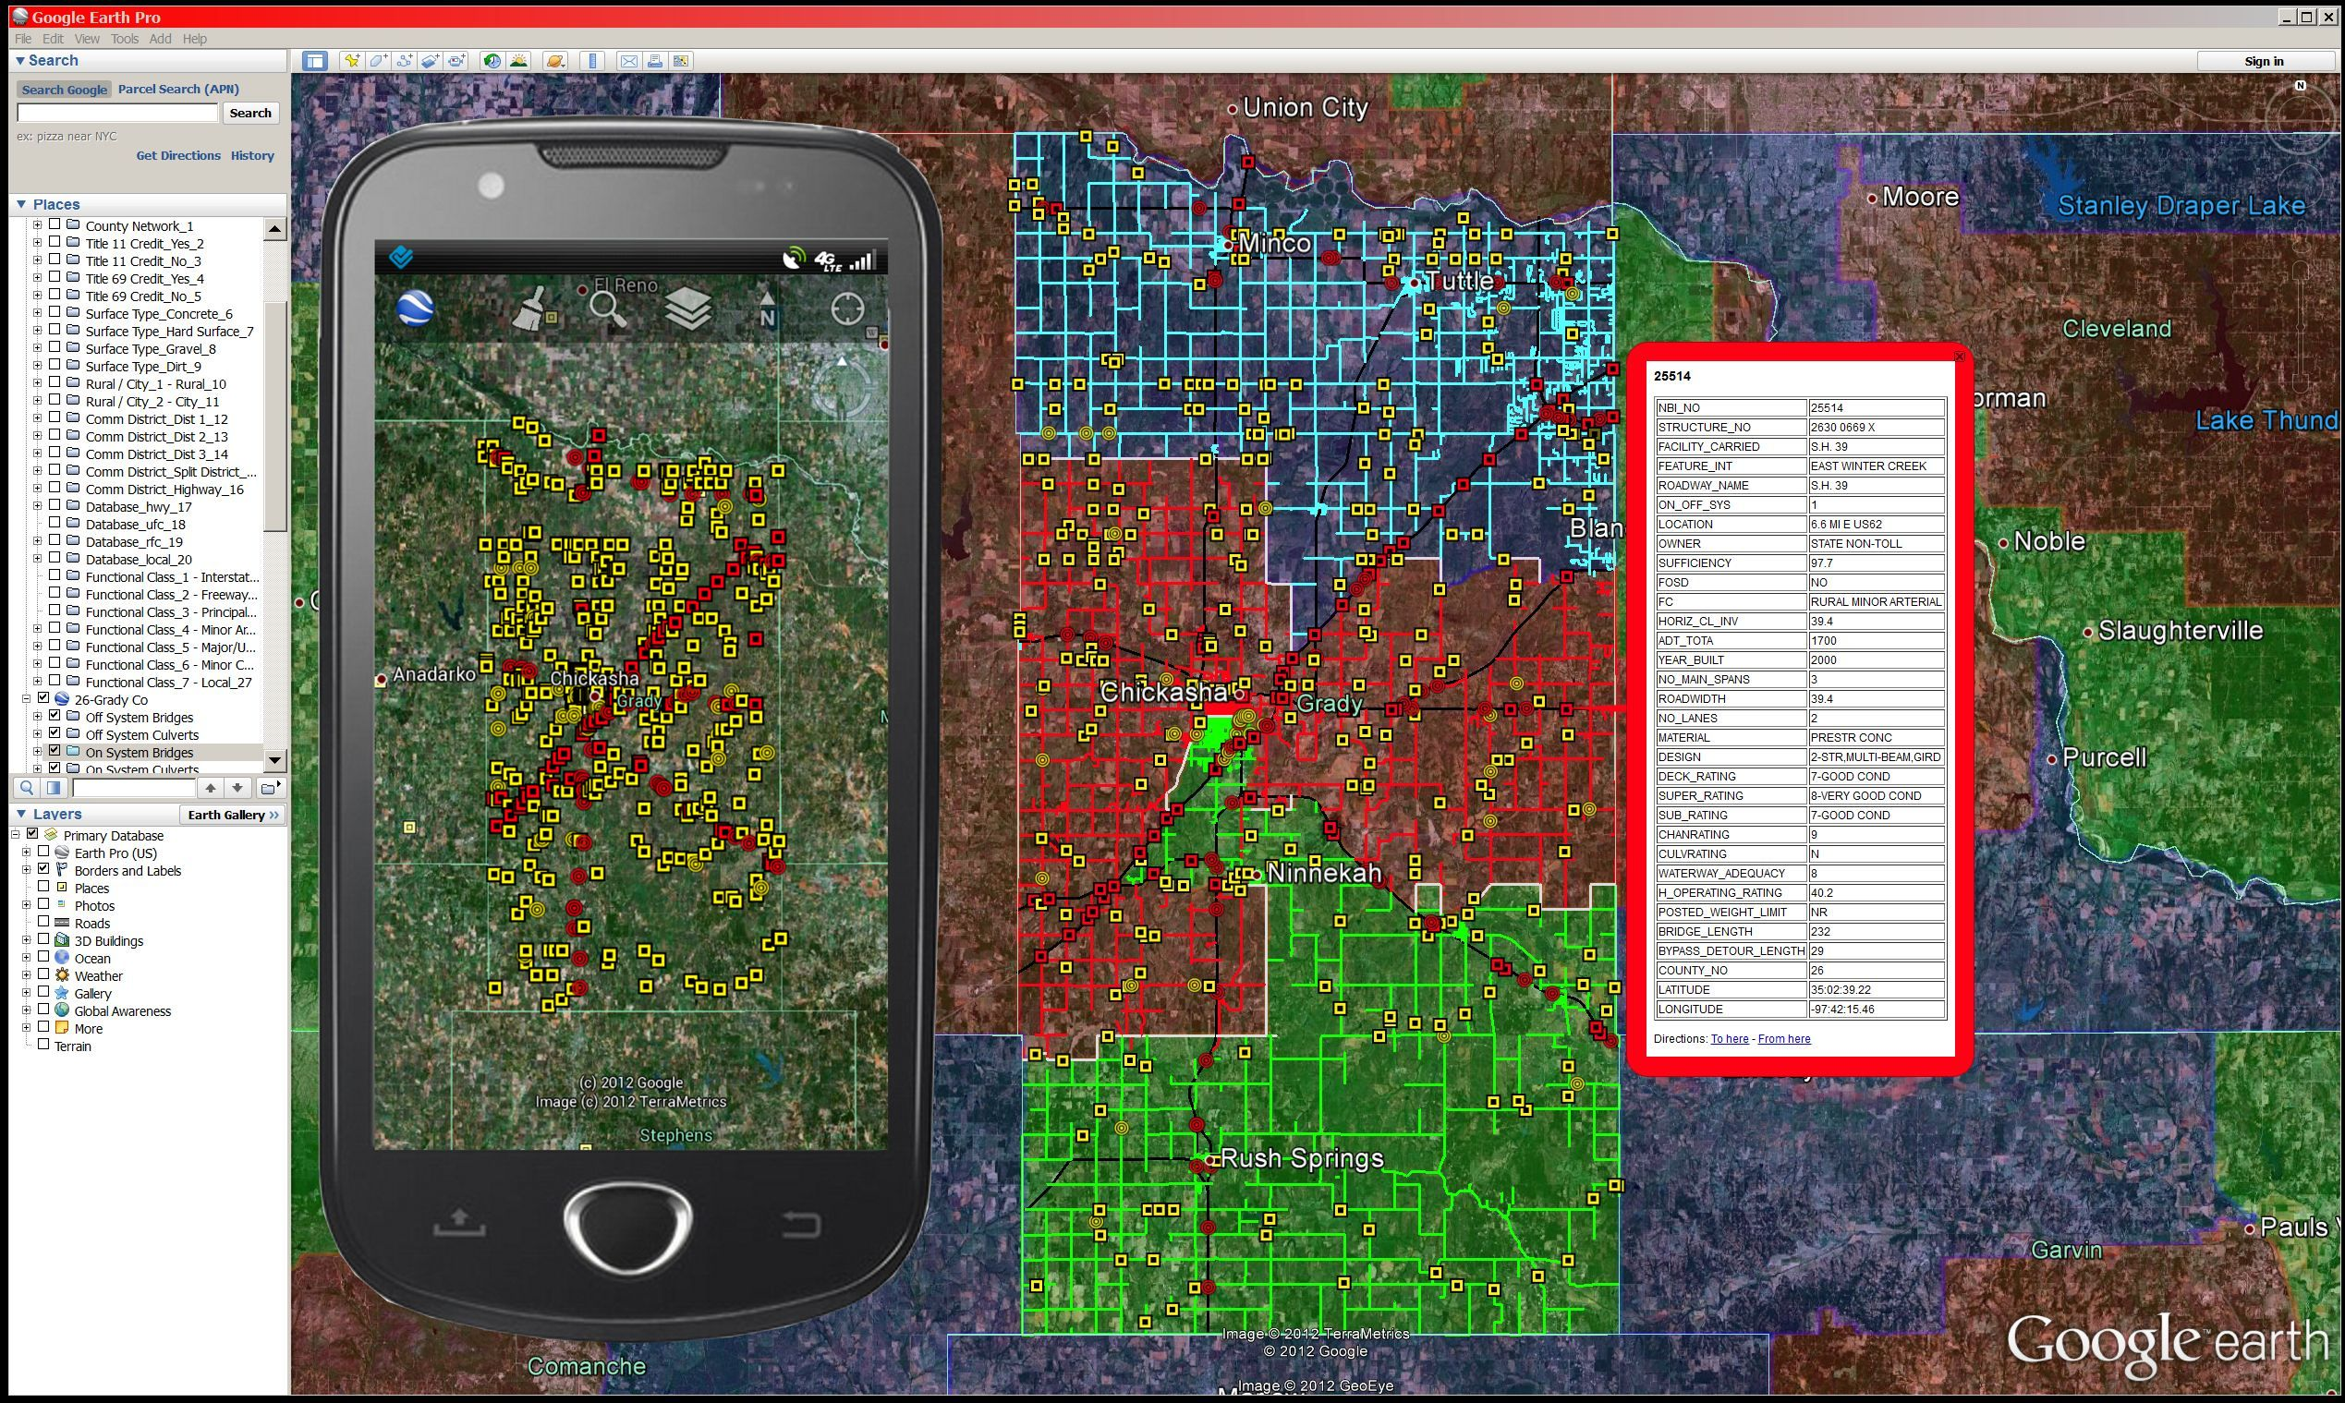
Improved Accessibility to More Platforms and Devices

