Slide 1
GIS Activities at NWS Norman with a Focus on the May 2013 Tornadoes
Aaron Anderson
Information Technology Officer
NWS Norman Forecast Office

Slide 2
Overview
Background on operations and staffing during events
Use of GIS during the May tornadoes
Other GIS activities both local and NWS wide

Slide 3
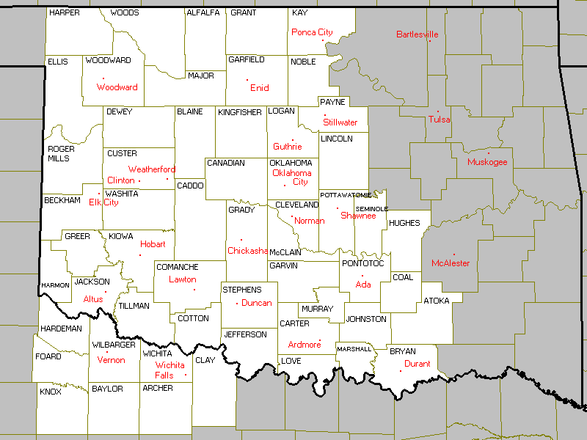
The Norman WFO
We issue forecasts
and warnings for…
48 counties in OK
8 counties in TX
47,546 sq. mi.
2.175 million people

Slide 4
May 20, 2013 WFO Norman Staffing

Slide 6
Tornado Path Application (TPA)
Goals
Easy to use operationally
Rapid updates
Simplify dissemination
Standard GIS formats (.shp, .kmz, .kml)
Advantages
Near real time GIS information
Aid first responders
Assist local, state, and federal EM community in planning response

Slide 7
Development
Location of rotation signature on radar and tornado on the ground can differ
Compared radar signatures to damage surveys
Developed algorithm to quantify track uncertainty based on distance from radar

Slide 8
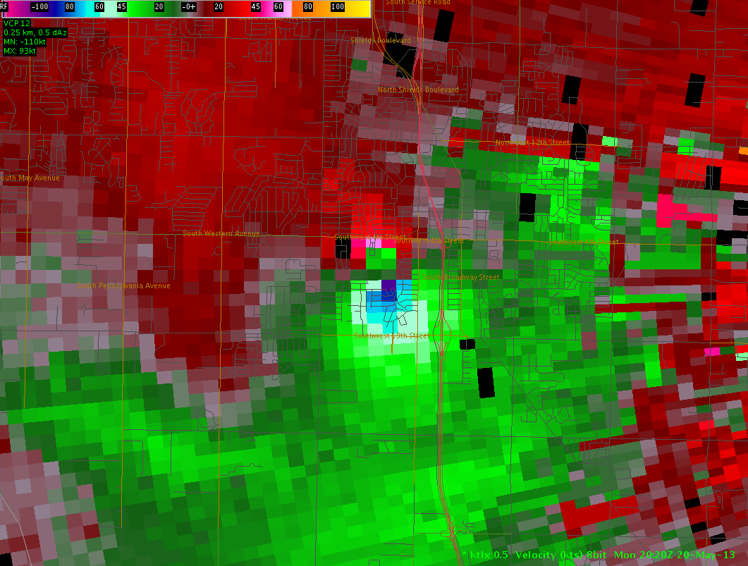
Operational Use
Forecaster selects point and radar being used in TPA
Updates point in AWIPS with each radar update
TPA stores positions, generates, and sends new KML file with each update

Slide 9
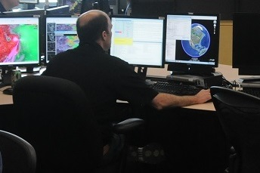
May 20 Tornado

Slide 10
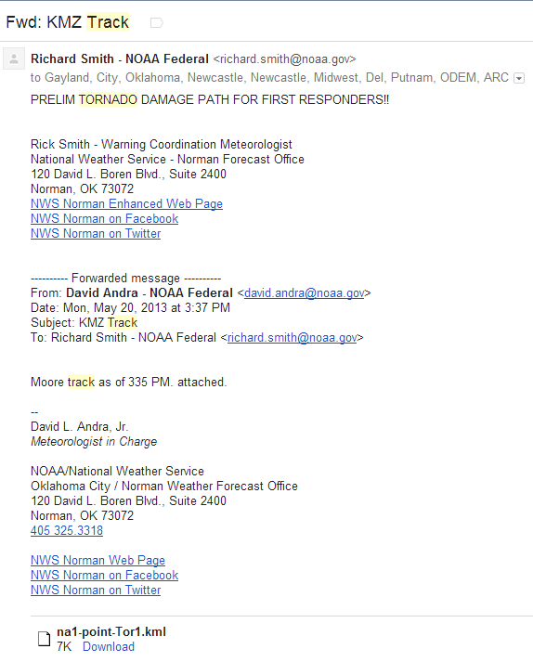
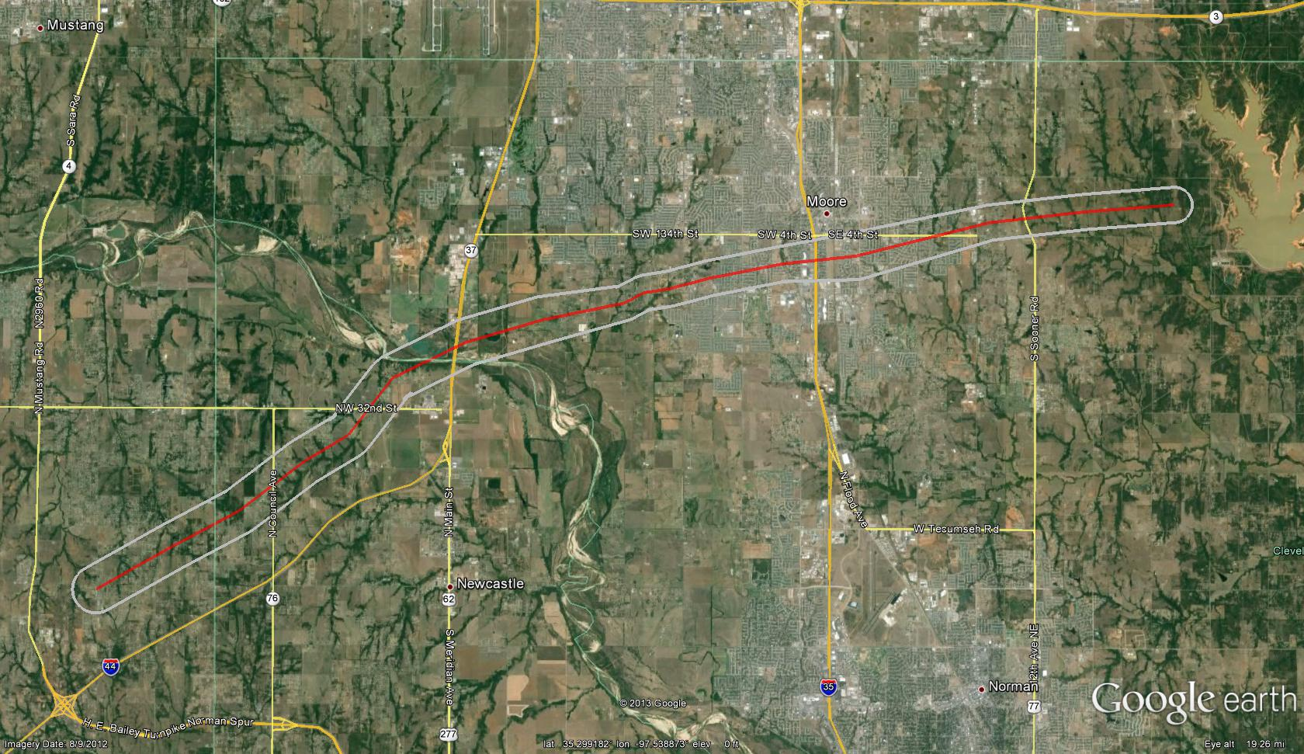
Preliminary Damage Path
3:13 PM and 3:43 PM

Slide 11
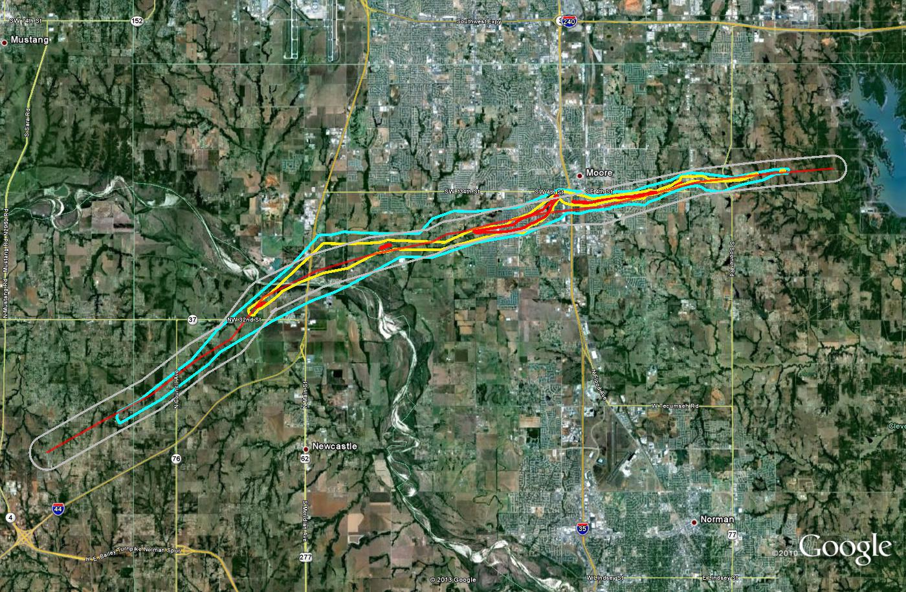
Radar Path vs Damage Survey May 20th, 2013 Moore Tornado

Slide 12
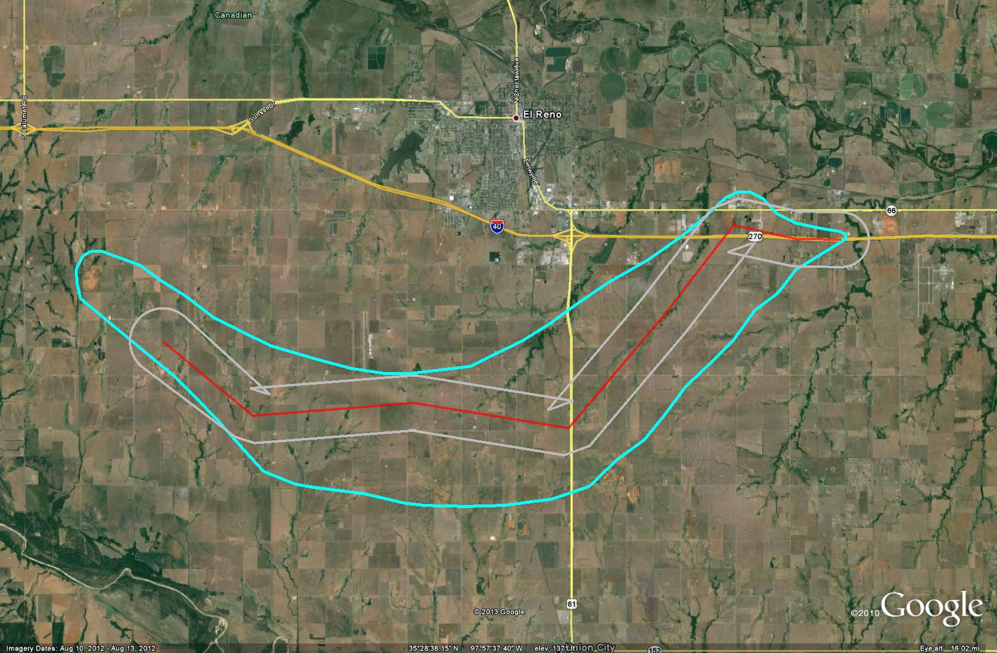
Radar Path vs Damage Survey May 31st, 2013 El Reno Tornado

Slide 13
FEMA Administrator Craig Fugate
FEMA used prelim tornado track data to deploy additional USAR teams to Moore before they were officially requested

Slide 14
Future Plans
Software
Add functionality
AWIPS2 Plugin
Integrate and capitalize on GIS architecture
How to best communicate uncertainty area
Dissemination
Determine best ways to share data with partners
NOAA Geoplatform, Geoserver, etc
Coordinate and collaborate with other NWS projects
Hazard Services
GIS in AWIPS

Slide 15
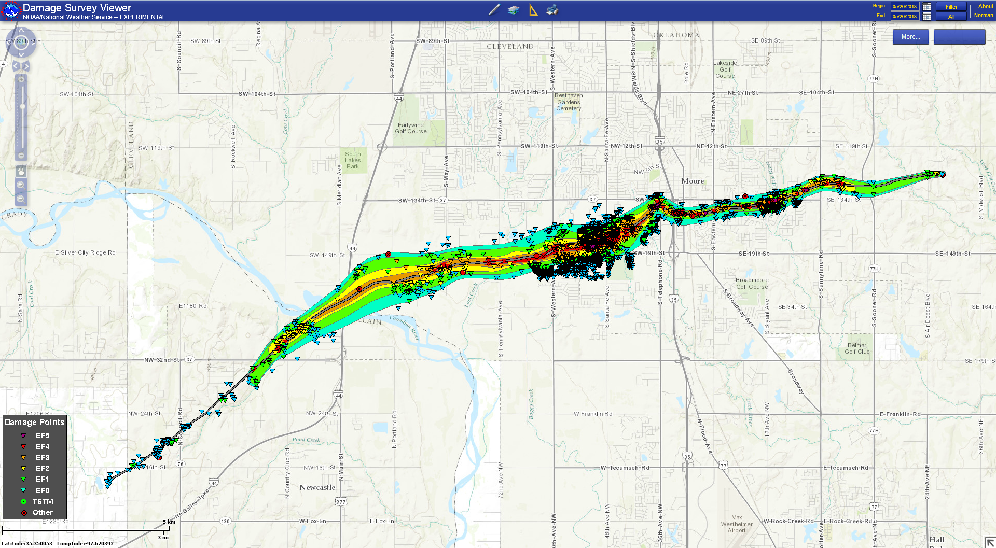
Damage Assessment Toolkit (DAT)
Main tornado survey tool
Enables rapid assessment of damage points
Ability to include photos/narratives for specific damage indicators

Slide 16
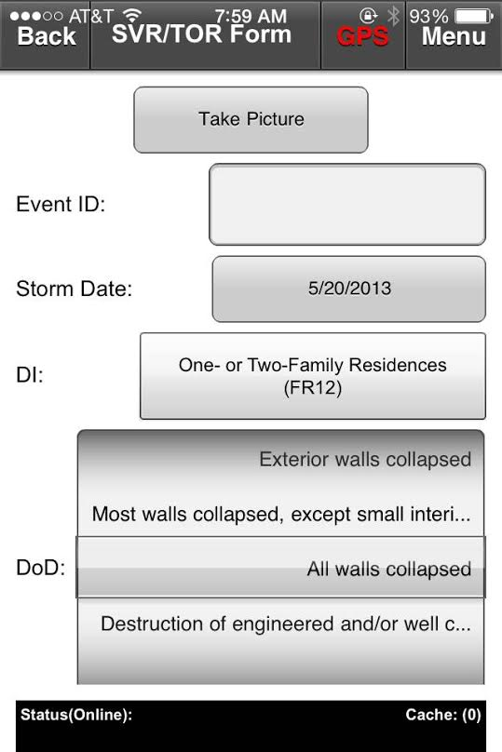
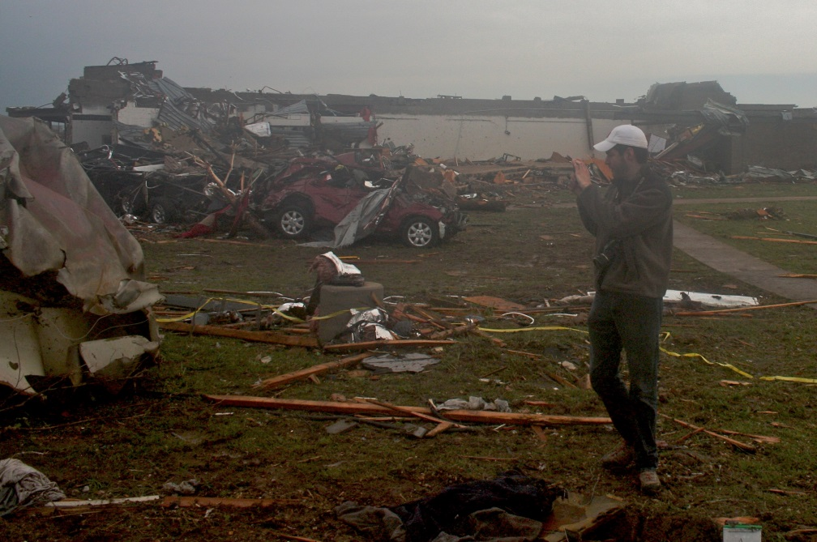
DAT on Portable Devices
Surveyors can enter damage information on smartphones and tablets

Slide 17
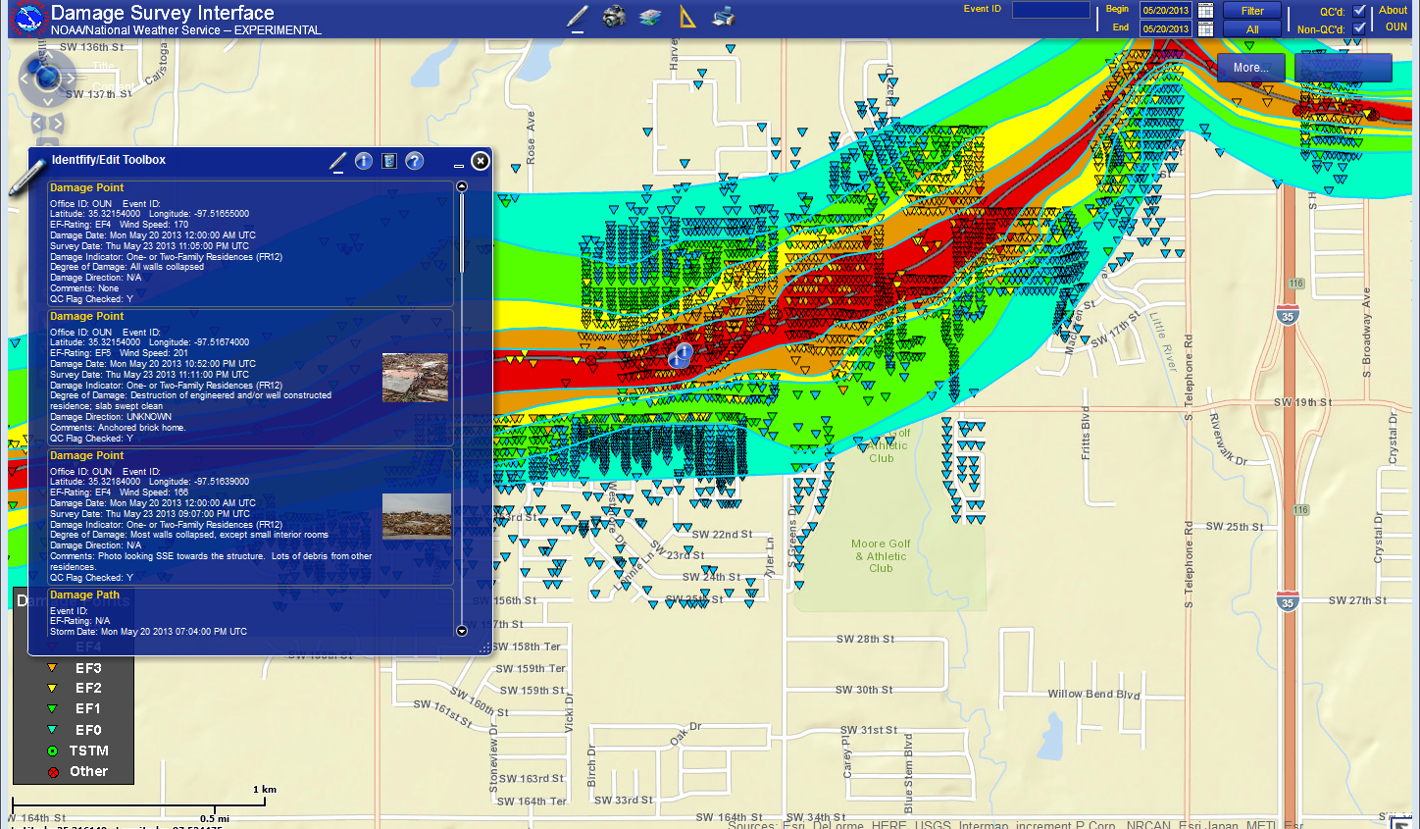
DAT Web Interface
Real time updates from field teams
Quality control
Export variety of GIS formats

Slide 18
Use of GIS Data from May Tornadoes
EM (planning and response)
Media (graphics, etc)
Planning aerial flyover assessments
Google Crisis Map (integrated with DAT)
Research
Lead time by population using Landscan data

Slide 19
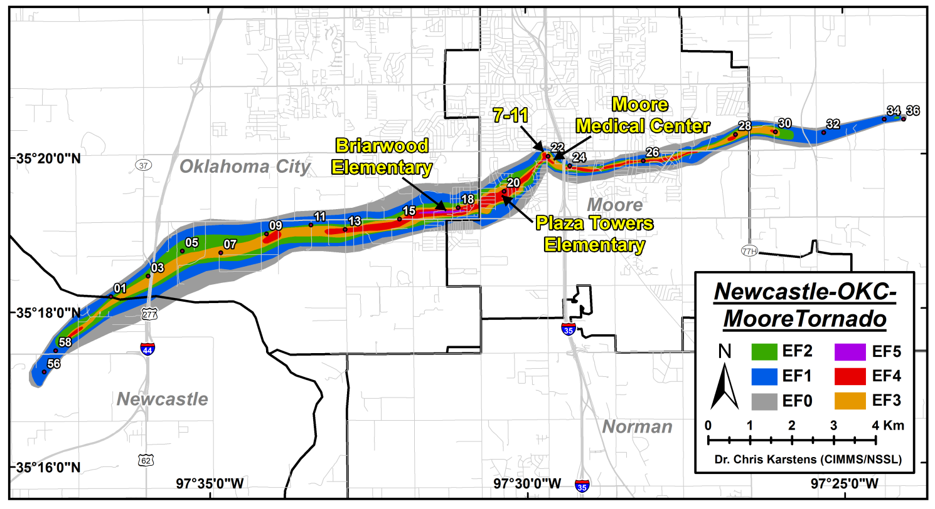
97% of the people in the path had
31+ minutes warning

Slide 20
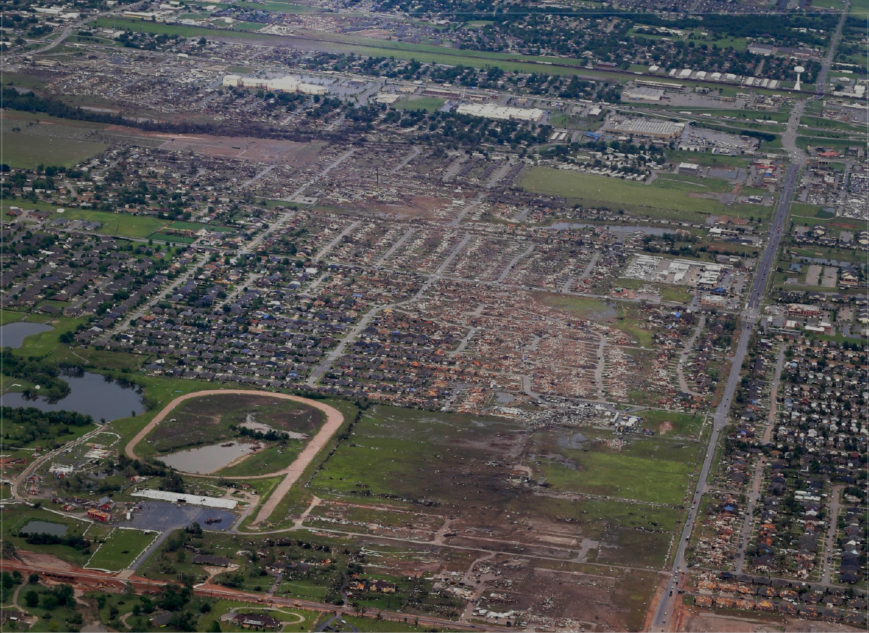
42 minutes
40 minutes
37 minutes

Slide 21
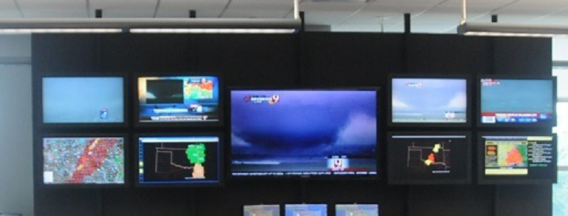
Local GIS Applications
Situational Awareness
Decision Support
Internal Web Apps

Slide 22
AWIPS 2
New operational software
Fully spatially enabled
Open source technologies (PostGIS, GeoTools, etc)
Provides underlying architecture for new capabilities and products

Slide 23
Geoplatform.gov
Centralized platform to discover and access GIS data and services
Similar to OKMaps but for Fed Govt
Early in deployment
www.geoplatform.gov/noaa/noaa-home

Slide 24
Questions?
Aaron Anderson
Aaron.Anderson@noaa.gov

